Slide 1
Laser Cutter Training
Trotec Speedy & Rayjet 300
Last updated: Furst 10/16

Slide 2
Description of the training
Training on the CNSI Workshop’s laser cutters comprises four parts:
Self-study (this slide deck)
An online quiz
An in-person review of the safe operation of the laser cutters.
Demonstration of competence during the review by making a simple part.

Slide 3
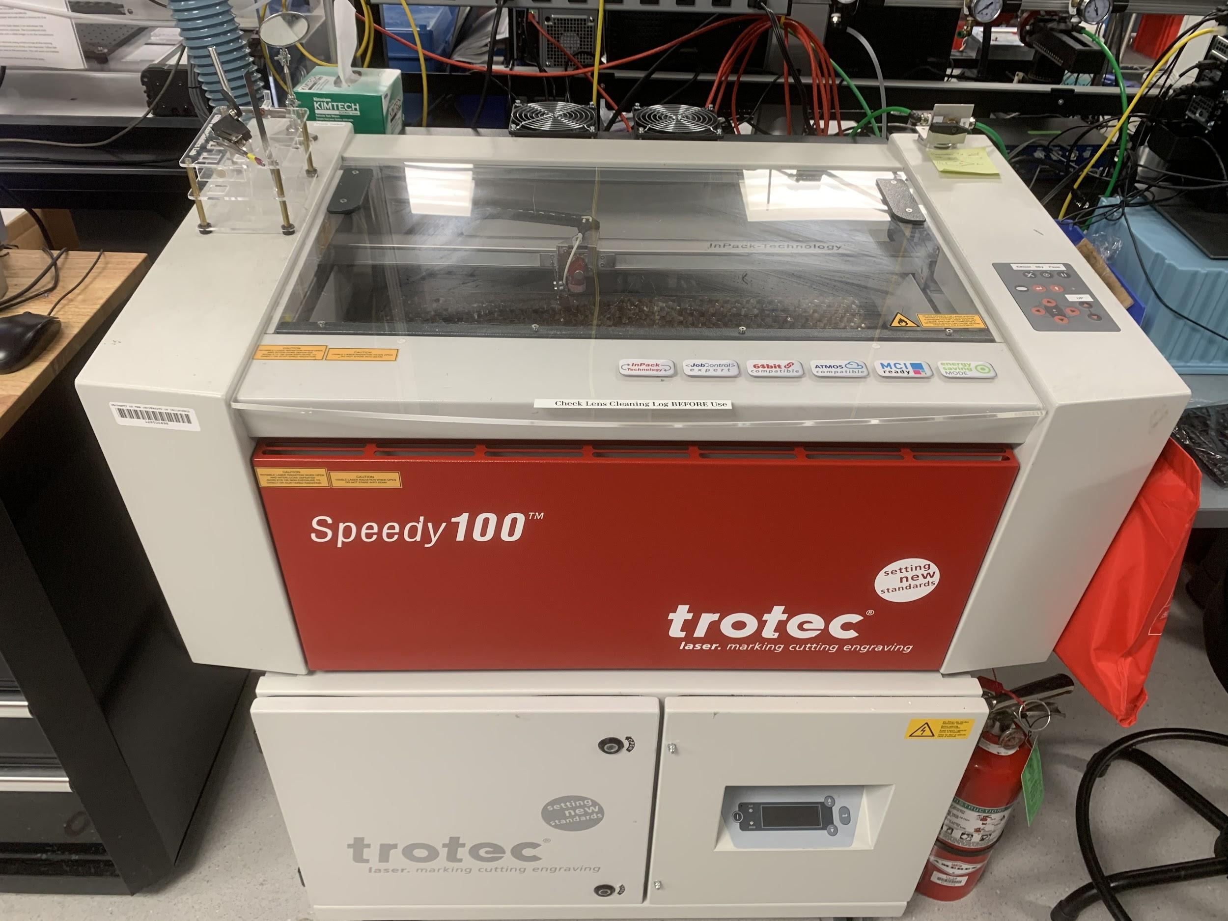
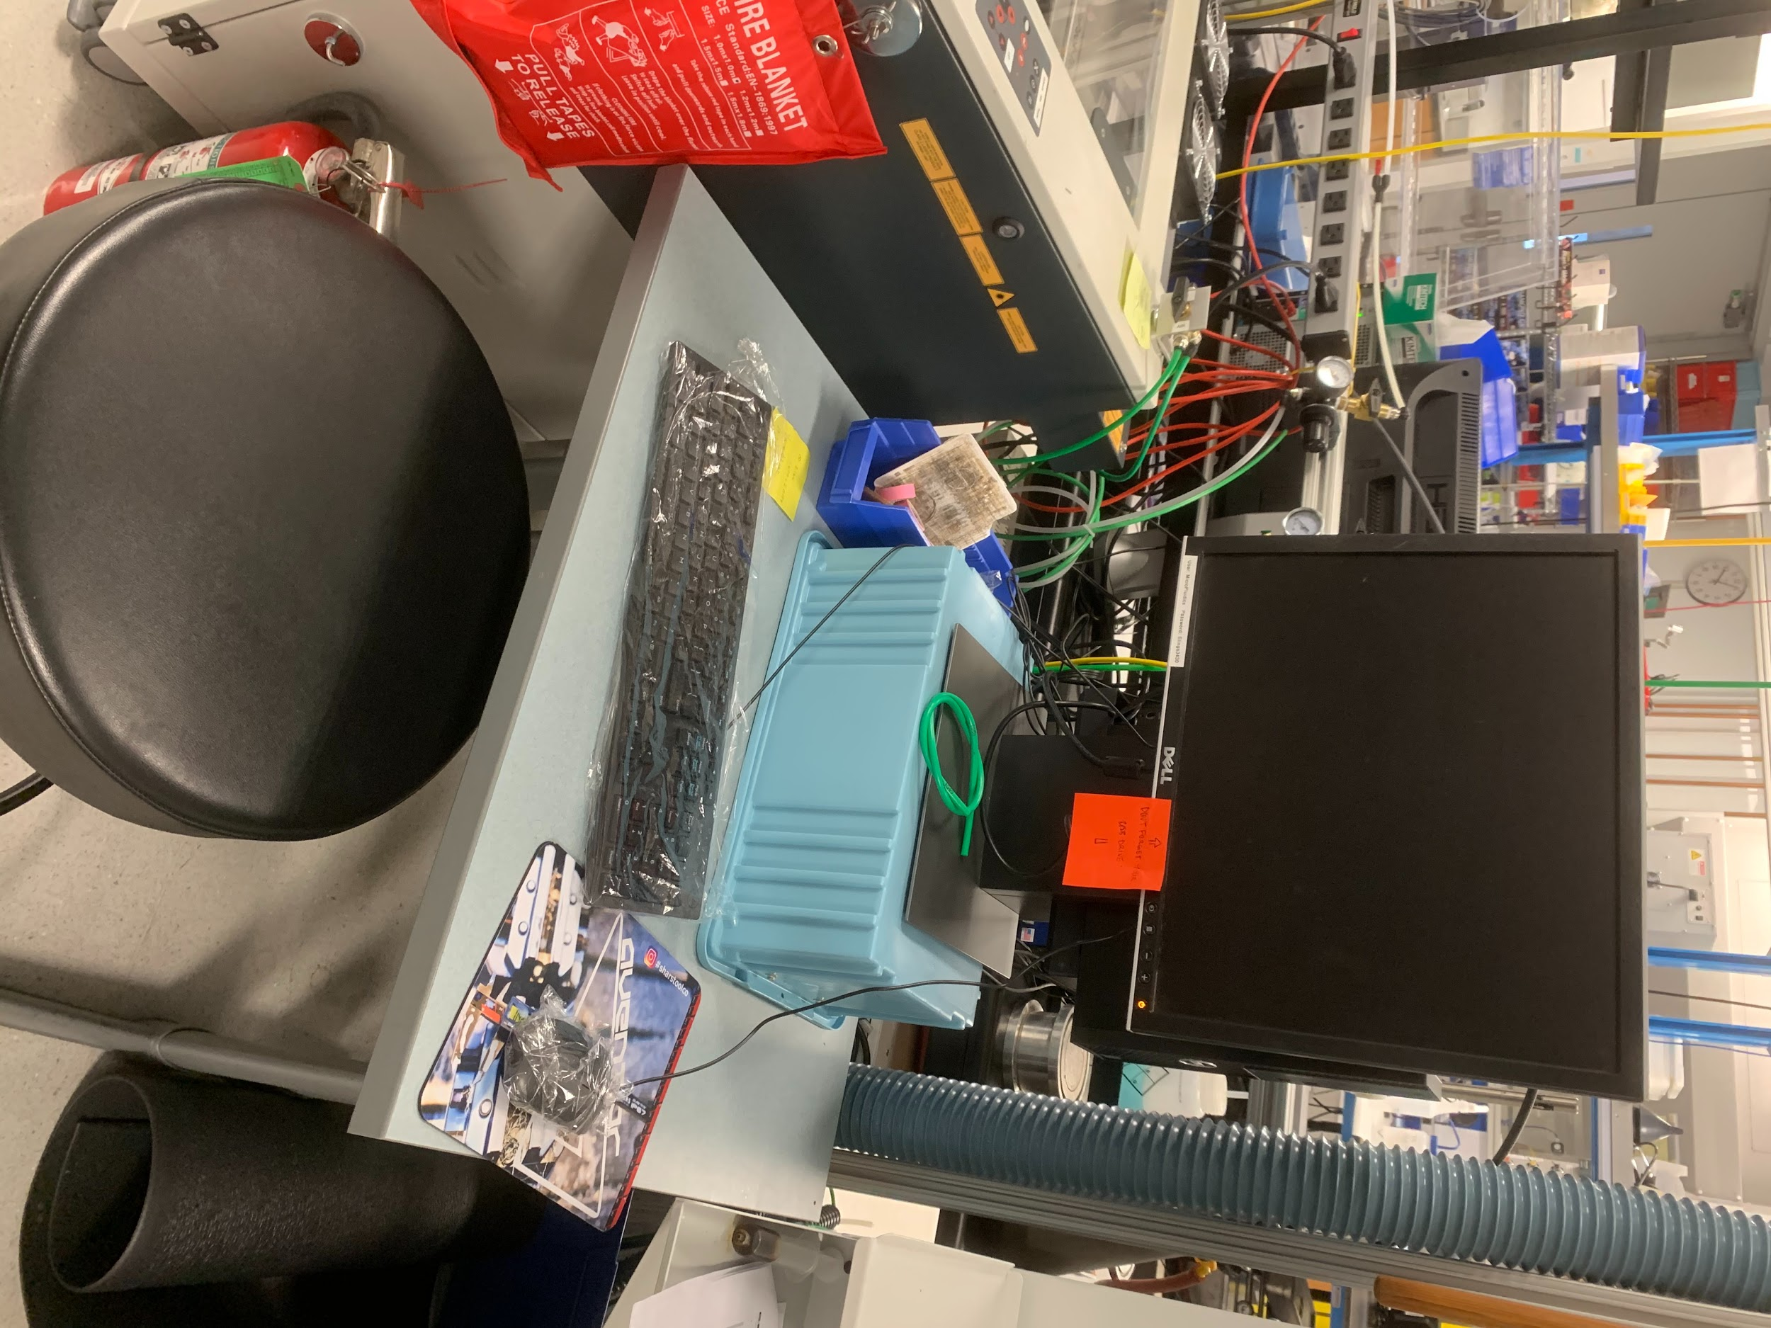
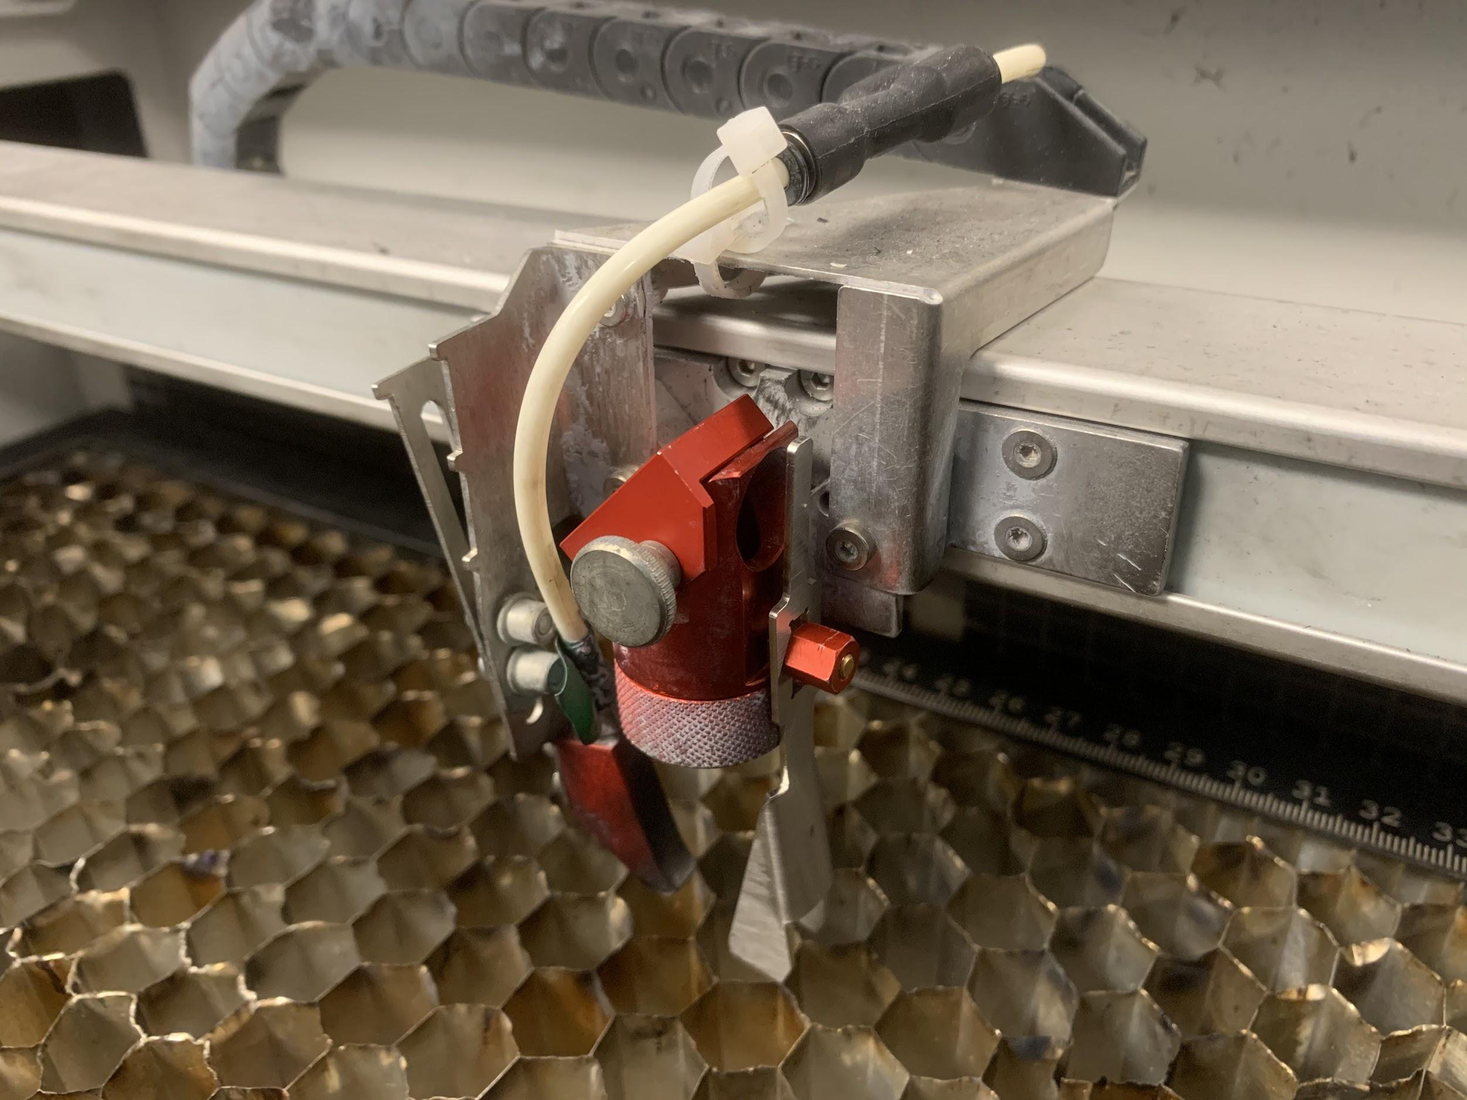
Key part of the laser cutters

Slide 4
Introduction to laser cutting
Our laser cutters use a focussed infrared pulsed CO2 laser (λ ~ 10 μm) to burn through organic materials. Not all organic materials can be cut with our cutter, so pay attention to the list of approved and prohibited materials later in the slide deck.
The beam diameter is about 80-120 μm. The laser in the Microfluidics lab is 30W (Trotec Speedy 100) and the Innovation Workshop’s laser (Rayjet 300) is 150W. The power density is very high, so care in preventing fires is very important. This is done by using the correct cutting parameters, and avoiding materials, such as polyethylene, that ignite easily.
The laser cutters have two modes of operation:
Cutting - where the laser follows the center of the lines and curves in your design file.
Engraving - where the laser cutter performs a raster-scan of graphics and text in the design file
A filter and exhaust fan carry dangerous vapors out of the room.
An air jet aimed at the focus of the laser extinguishes mini-fires that ignite, and carry fumes away from the lens

Slide 5
Using the laser cutter
The steps to using the laser cutter are:
Create a graphics file showing the areas to be cut and engraved. This is usually done before coming to the lab using your own design software. Save the design file in .pdf or .dxf format.
Open the design file in Coreldraw on the laser cutter computer to adjust the colors and line widths of the features, and assign the correct print settings to the job for the material that you are processing. Also, on the Innovation Workshop laser cutter you will position your part where is should be on the bed of the laser cutter.
Turn on the laser cutter, and start Job Control, the Windows software that controls the cutter. Connect the cutter to Job control.
Place your material on the bed and focus the laser.
Print the file in Coreldraw, sending the file to Job Control, the software that actually runs the laser cutter.
Make any final adjustments in Job Control and run the job.
Clean up and turn off the laser cutter. Coreldraw and Job Control may be kept running.

Slide 6
Detailed operation - outline
File Types
DXF
PDF
Software
Corel Draw
Job Control (JC)
Safety and Hazards
Fire
Material safety and selection
Laser Cutter Use
Cutting
Engraving
Laser Cutter Maintenance
Head cleaning
Atmos Compact Exhaust system

Slide 7
Safety
Follow all of the general lab safety rules: long pants, closed-toe shoes and safety glasses are required at all times in the lab.
Laser safety - don't look at the light or put reflective materials on the bed. (Note: the red HeNe laser is not dangerous - it is concentric with the IR laser, and is on at all times to align the laser with the workpiece.
NEVER let machine operate unattended - this can lead to fires.
A Halon fire extinguisher and a fire blanket are located next to the machines.
The exhaust fumes

Slide 8
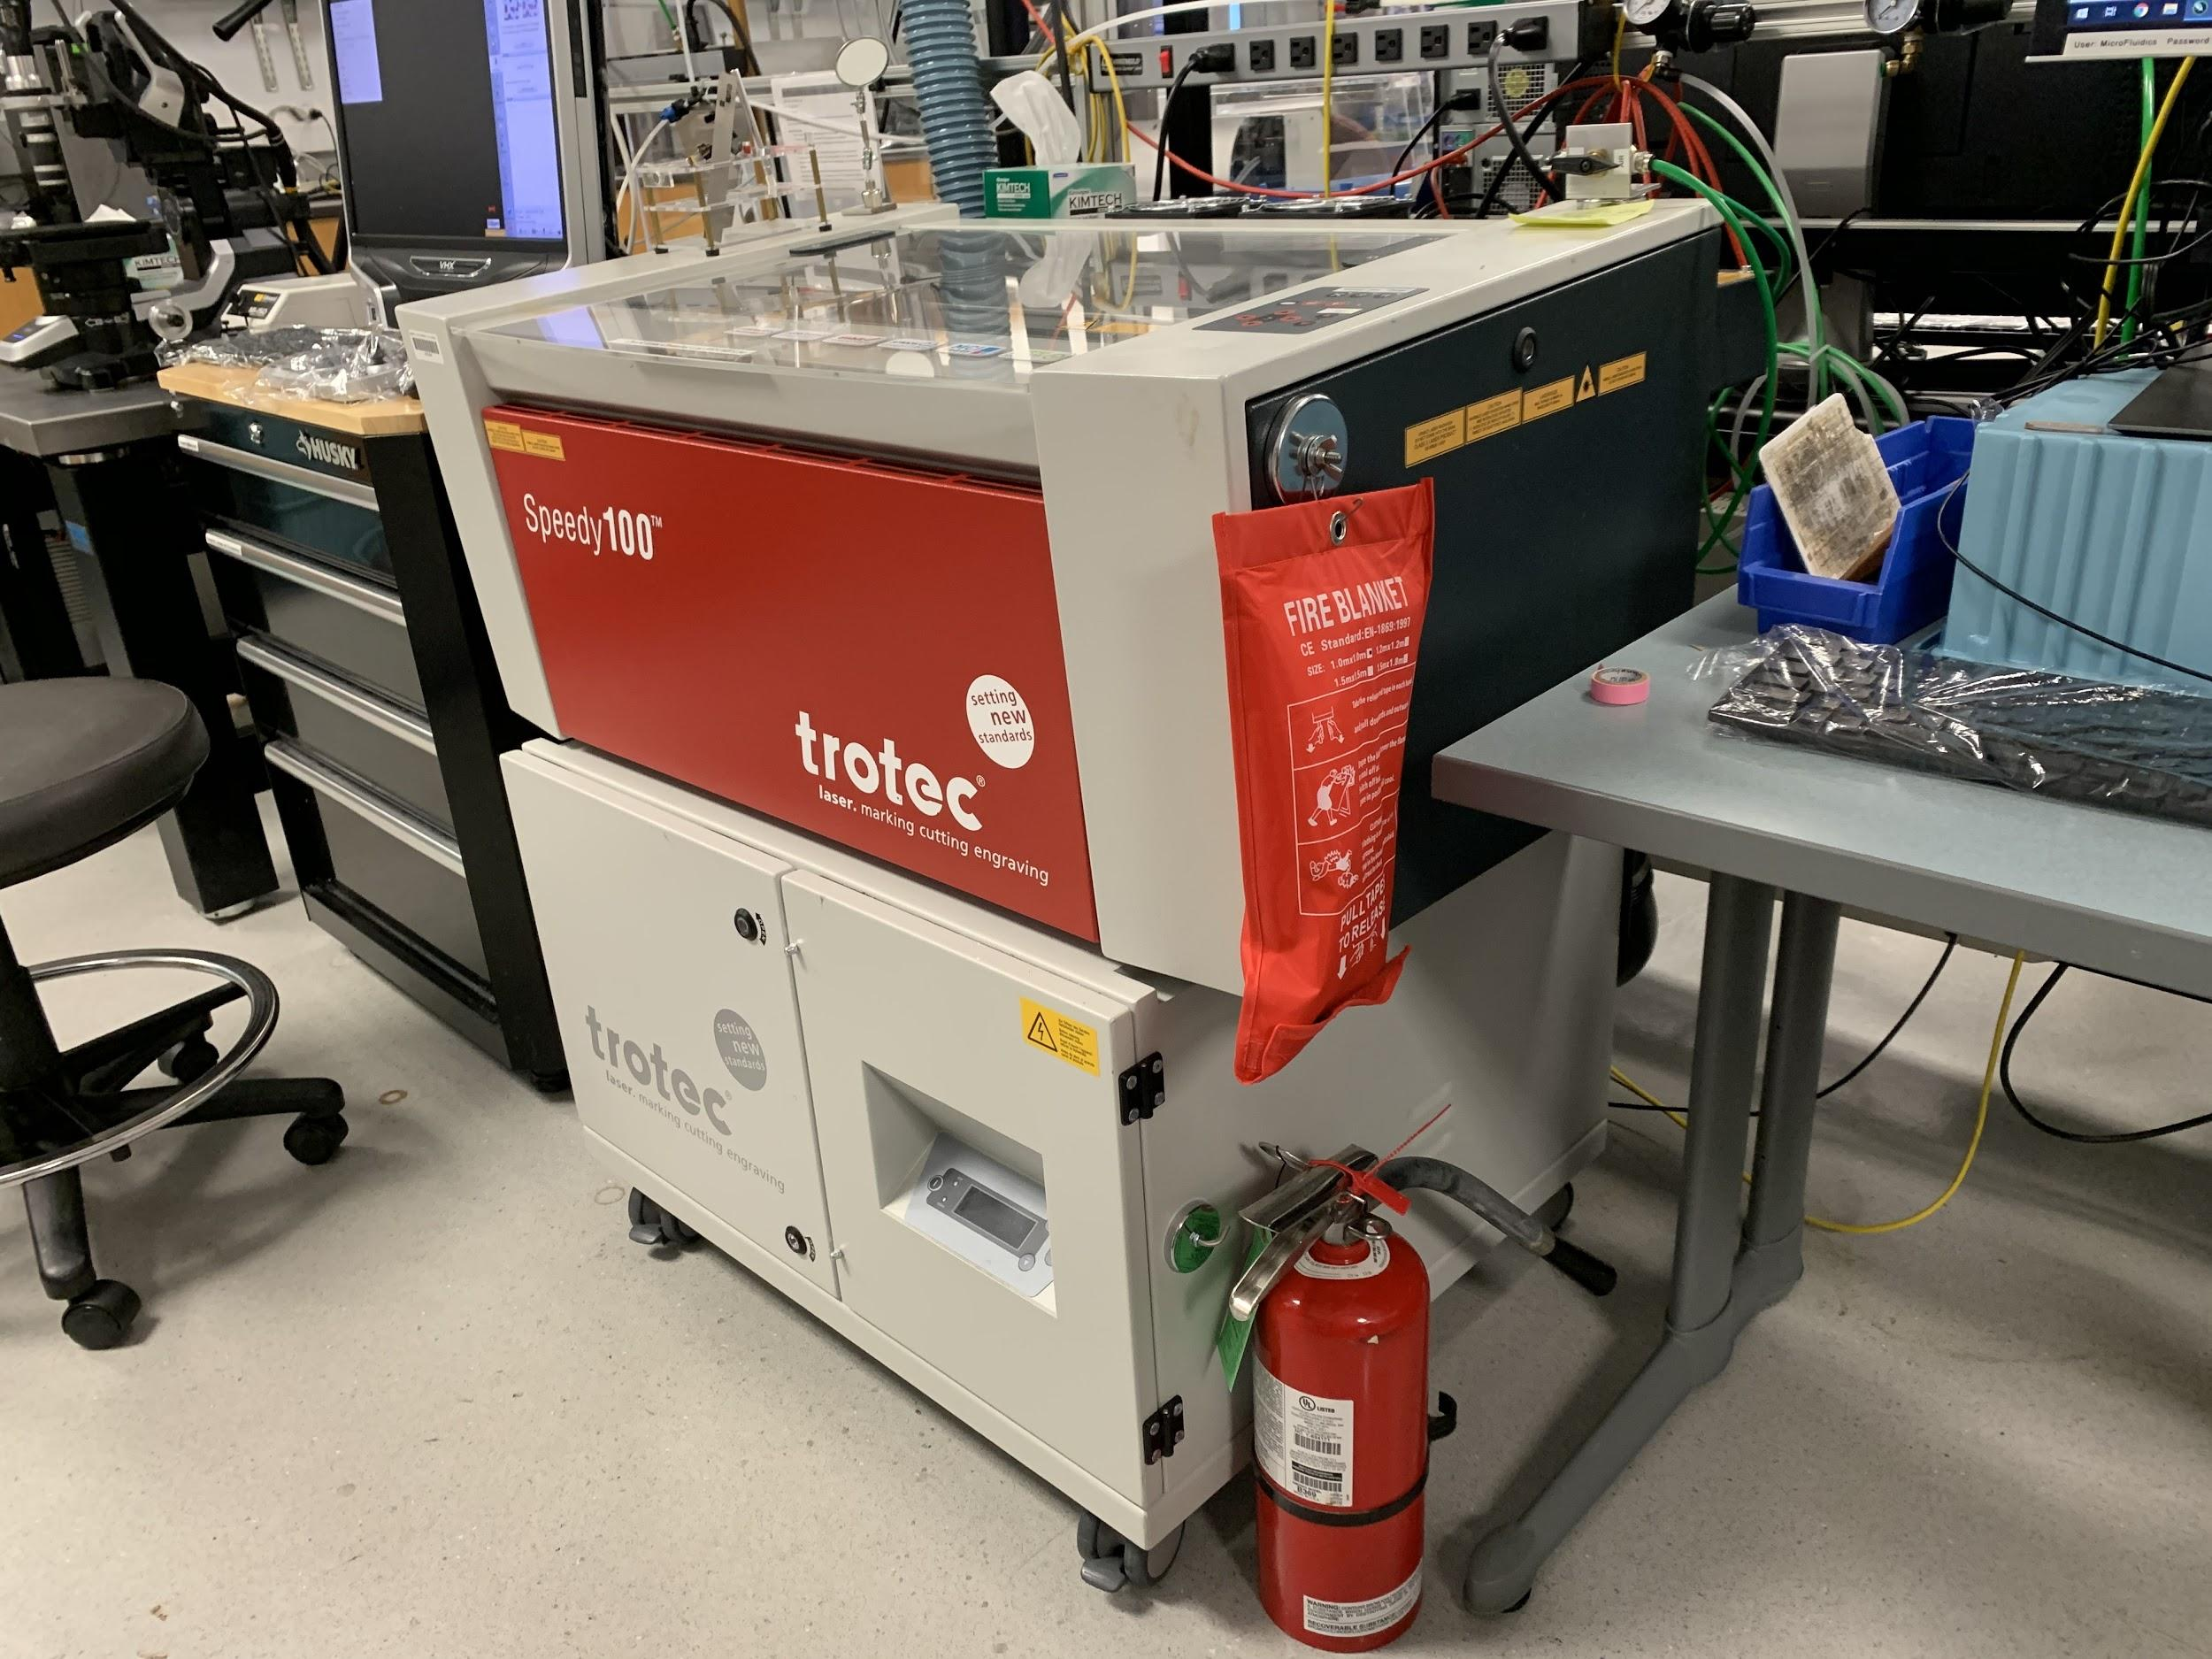
Observe the fire extinguisher and fire blanket at every laser cutter

Slide 9
Material Selection
Approved Materials:
ABS
Acrylic
Delrin
Kapton Tape
Mylar
Nylon
PDMS
PETG
Polypropylene
Styrene
Two tone acrylic
Wood
Depron Foam
EPM
Prohibited Materials:
ANY METAL (could damage machine optics)
Polycarbonate (creates fumes that could damage optics)
Teflon (creates fluorine gas)
ANY material containing Chlorine
PVC
Vinyl
HDPE (catches on fire)
Glass (can engrave but can't cut)
Fiberglass
PCB
Carbon Fiber

Slide 10
At the Computer (CorelDraw)
Launch CorelDraw and import DXF or PDF file of part to cut
Select the part, set all lines to HAIRLINE, delete any unnecessary features
Lines to cut should be RGB red
Features to engrave should be filled RGB Black
Highlight and drag position of file to top left corner of the bed within Corel Draw
Click Print, then print settings to open Trotec engraver settings ( or rayjet control manager)
Select the desired recipe within Trotec engraver settings for corresponding material thickness
Ensure autofocus is disabled, cut inner geometries and minimize to job site is enabled
Click the JC icon then print to send job to job control

Slide 11
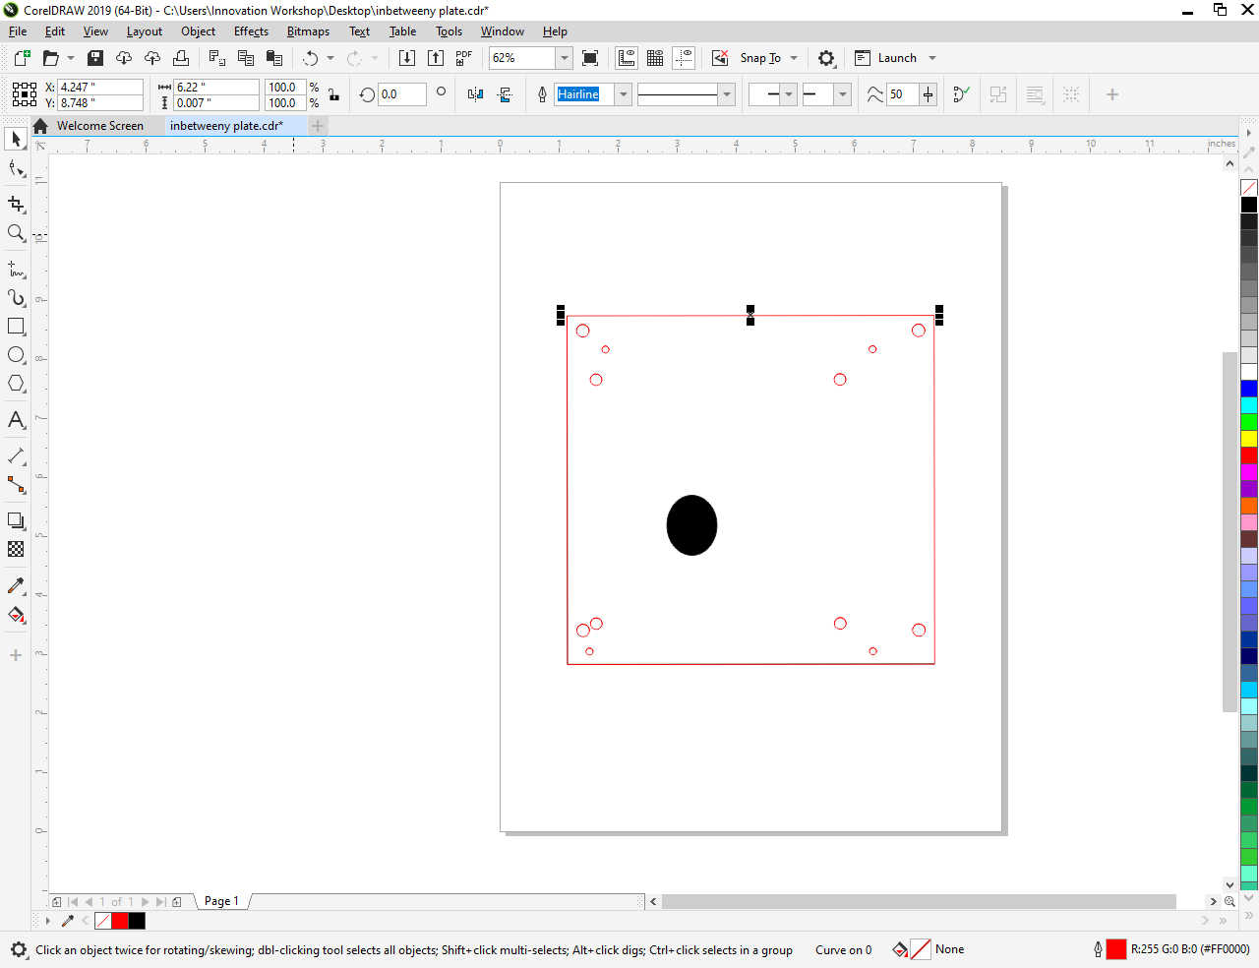
Example of Part within CorelDraw
Lines set to Hairline
Engravings set to RGB Black
Lines to be cut RGB red
Notes:
Point out RGB red in bottom right corner, Hairline thickness of all the lines from top toolbar (highlighted) , this is going to engrave an ellipse and cut out some holes and a plate

Slide 12
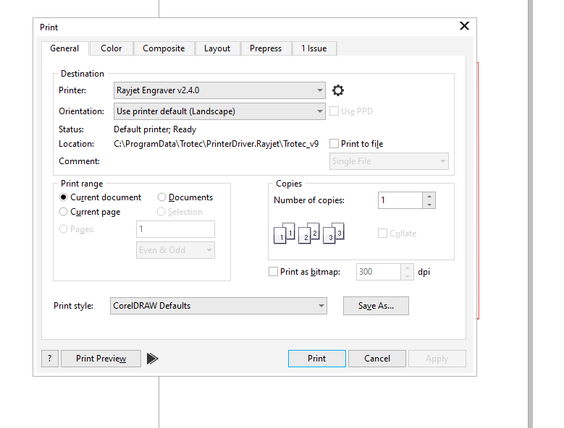
Print Screen
Gear to bring up trotec engraver properties (see next slide)
Send job to Job Control (see slide 18)
Notes:
Press that setting button next to selected printer (rayjet or trotec)

Slide 13
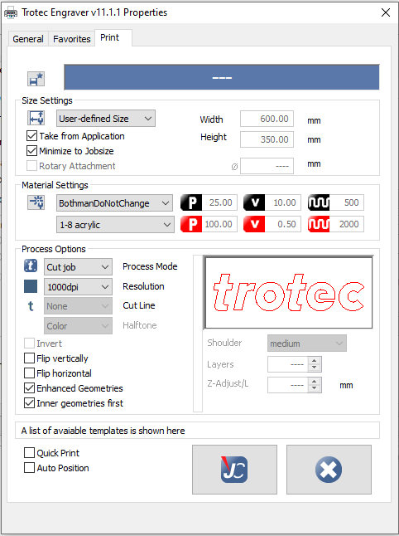
Trotec Engraver Properties
Make sure these are checked
Select Recipe user and material
Click “JC” then Print
Notes:
This occurs when pressing settings button, two dropdowns, the one that says bothmandonotchange selects user, daniel also has some good recipes to steal
Second drop down is the 1-8 acrylic which I assume to be ⅛” acrylic, can choose from different recipes

Slide 14
At the Laser Cutter
Turn on the laser cutter (the machine will home itself lowering the bed all the way)
Raise the bed using the 2 arrows until close to cutting head
Place object to be cut on the bed and position head over workpiece using D-pad
Rest the focusing tool on its ledge on the side of the cutting head
Slowly jog the bed up until the focusing tool contacts the workpiece causing it to fall from its ledge
Position the cutting head over desired starting location on workpiece (¼ inch from top left corner)

Slide 15
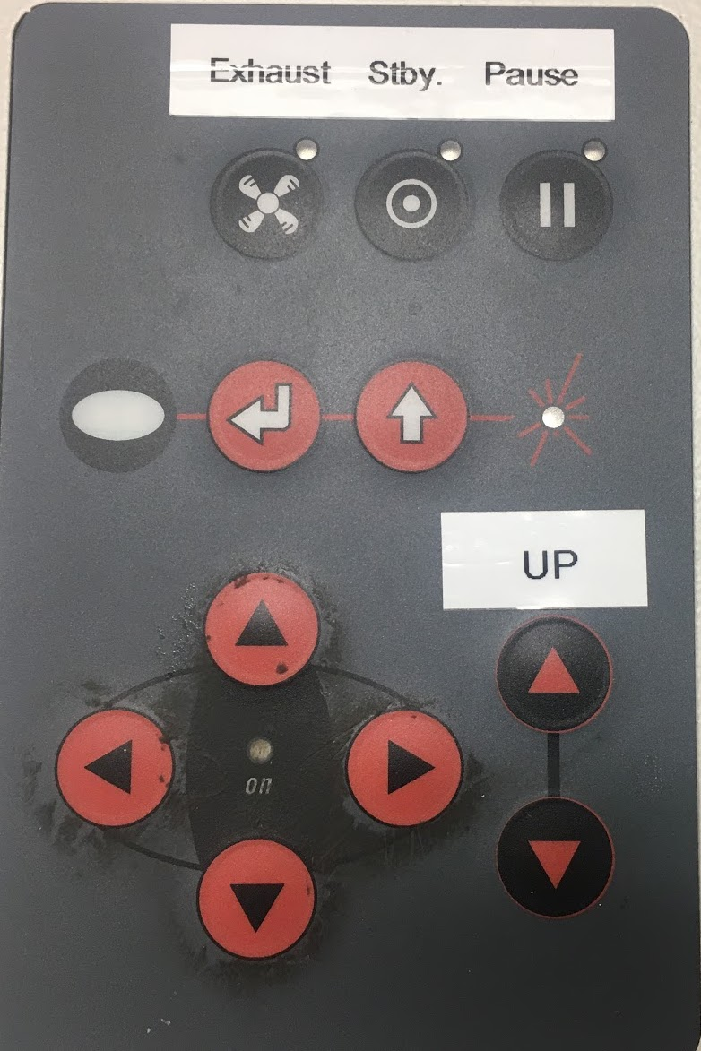
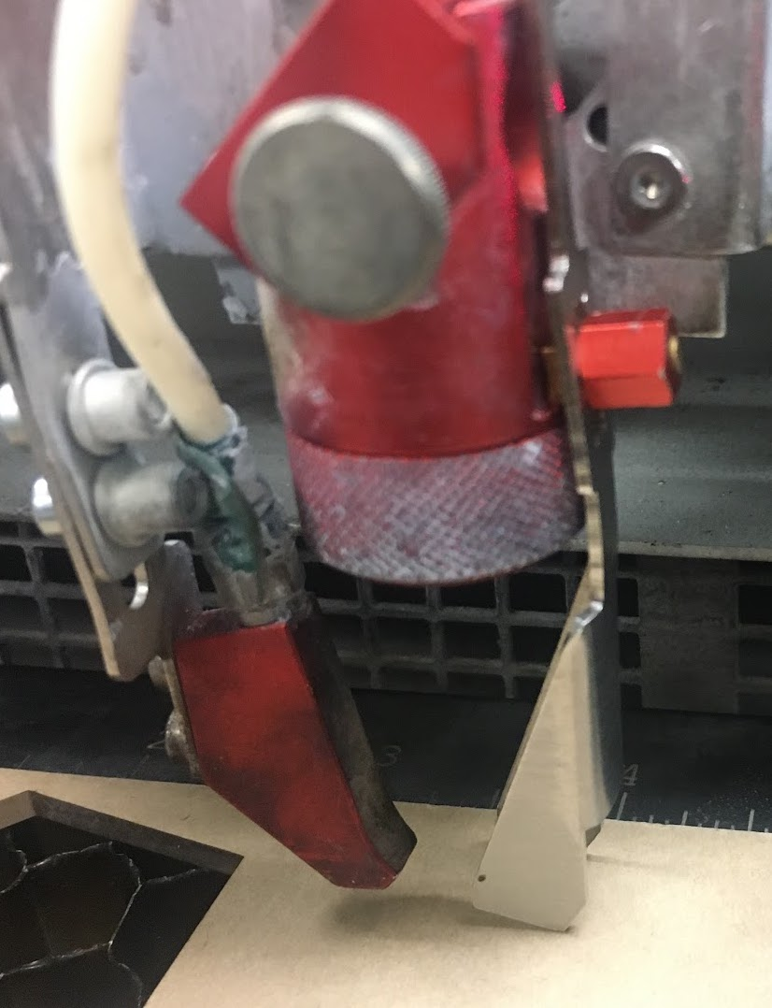
Laser controls and focusing
Mirror
Focusing Lense
X, Y Positioning
Air Blast
Focusing Tool
Z Positioning
Notes:
Control panel and focusing tool

Slide 16
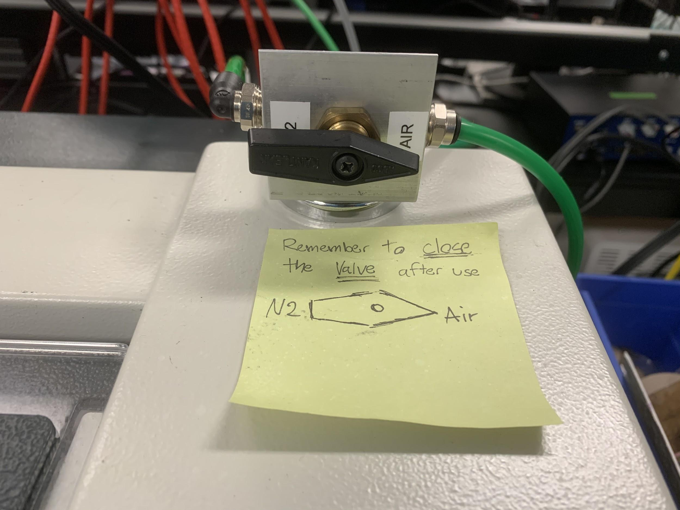
Nitrogen system for cutting rubber
If you plan on cutting rubber or materials prone to igniting with the laser using nitrogen is recommended to reduce the chance of fire.
Switching the airblast to nitrogen can be done by turning the 3 way valve to N₂.
Be sure to turn the valve back to “air” after cutting to preserve N₂

Slide 17
At the Computer (Job Control)
Click the USB icon to connect the computer to the printer
Drag the imported part from CorelDraw to the crosshairs (location of cutting head)
Double check cutting Recipe and workpiece/cutting head location
If nitrogen is required turn both flow control knobs to nitrogen (be sure to turn off the nitrogen after cut is complete)
Outline of part can be traced by the cutting head by right clicking “preview”
Click play button to start cut
Try to avoid looking directly at the laser despite having to watch the machine
Turn off printer, turn off nitrogen, remove scraps, close lid

Slide 18
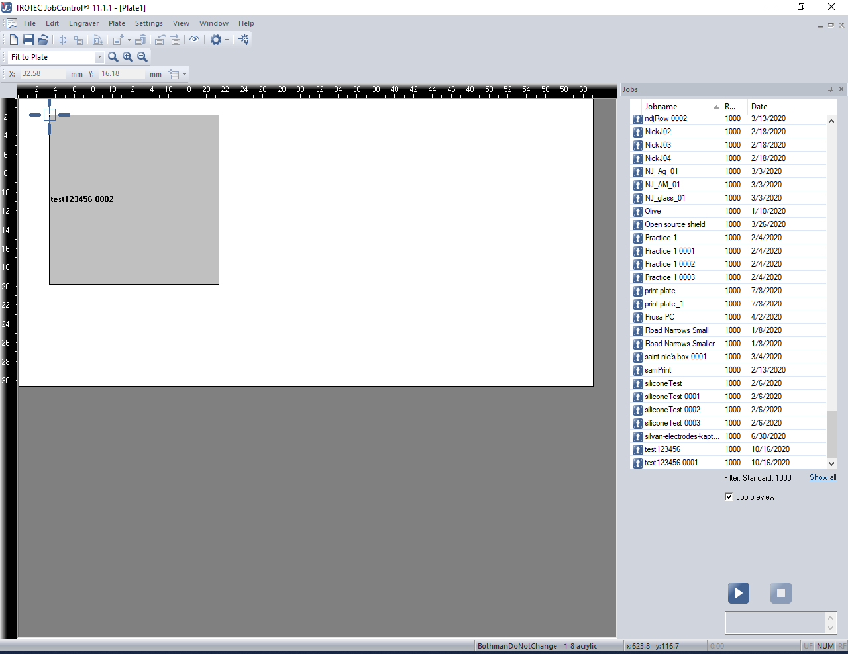
Notes:
Connect laser by pressing USB icon (will appear where the play button is if not connected). Can drag job from right hand list, drag to crosshairs which displays where the cutting head is in relationship to the bed.

Slide 19
Recipes for Acrylic for Trotec
Thickness | Engraving Settings | Cutting Settings
1/16in | 50% Power, 25%speed | 100% Power, 0.6% Speed
1/8in | 50% Power, 30% Speed | 100% Power, 0.45% Speed
1/4in | 50% Power, 30% Speed | 100% Power, 0.2% Speed

Slide 20
Recipes for Acrylic for Rayjet
Thickness | Engraving Settings | Cutting Settings
1/16in | 40% Power, 100% Speed | 100% Power, 5.0% Speed
1/8in | 40% Power, 100% Speed | 100% Power, 2.5% Speed
1/4in | 40% Power, 100% Speed | 100% Power, 1.0% Speed
1/2in | 40% Power, 100% Speed | 100% Power, 0.3% Speed *Must focus laser in center of material, remove paper*

Slide 21
Troubleshooting
Insure that all lines are single lines or cutter will cut go over cut twice
If cutting thicker stock may have to focus laser to ½ thickness stock instead of stock top
If on Rayjet, opening Rayjet minimanager can be done from taskbar notifications icons if already running
If Rayjet minimanager is not receiving files from CorelDraw try clearing the files que in the minimanager

Slide 22
Laser Cutter Maintenance: Cleaning the lens
This is usually done weekly by the Workshop Wizards to remove particulates which decreased reflectivity of the lense and therefore decreases lens lifespan. Users planning on cutting significant amounts wood, rubber, or PDMS should clean lense after use.
Turn laser off
Wearing nitrile gloves, place bubble wrap under lens before unscrewing
Once removed, blow off with compressed air, wipe with cleaning solution found in laser cutter bin on both sides, allowing some time for solution to sit
Remove mirror by unscrewing retaining screw(s)
Clean in same fashion as lens
Replace lens and mirror
Log cleaning of lens

Slide 23
Laser Cutter Maintenance: Particulate Filter Change
Usually done by staff (will not be on quiz)
Turn off the Atmos and unplug the main.
Open the filter housing, the black drawer will be seen on the left.
Unplug the measurement hose (connected to the front of the drawer) and carefully pull the drawer out of the housing.
Unscrew the front of the drawer, this area is the activated carbon housing.
Remove activated carbon and the filter mats (located on sides) into a garbage bag and replace with new mats, blue imprint towards exterior of drawer
Pour in a limited amount of activated carbon to retain mats, then fill
Close the chamber with the fasteners.
Slide the drawer back into housing. Make sure that the filter is sitting firmly and is attached airtight to the back of the housing.
Reset the error signal by pressing “+” and ”-” on the control panel consecutively for 3 seconds.

Slide 24
Review
PDF and DXF files are the most common file types CorelDraw accepts
Do NOT cut metal, anything with Chlorine, polycarbonate, PCB … When in doubt, CHECK FIRST
Do not leave a laser cutter running unattended
Lens should be cleaned at least once a week
Job Control only knows to cut hairline RGB red and engrave RGB black
Focusing is done with the balancing focusing tool on the cutting head
Job Control = Rayjet MiniManager
Set cutting recipe before starting any cut

Slide 25
Next steps
Take the online quiz. You can find the link on the laser cutter section of the Workshops Wiki.
Review the laser cutter manuals - also on the Wiki so that you know what information is there if you have questions.
Schedule an in-person training if you haven’t already done so.
Design a keychain in your CAD software of choice. Stay within a 1.5 in. x 3 in. envelope. Include both cutting and engraving operations. Save the file in .pdf format and bring it with you to class.
You will make your parts at the end of the training.

